Slide 1
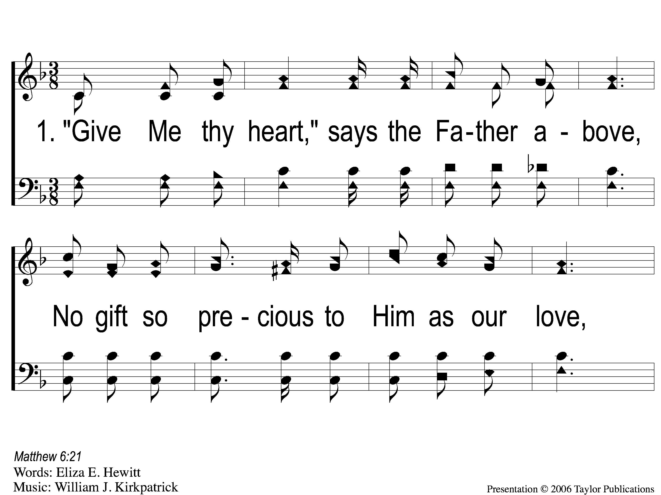
1-1 Give My Thy Heart
Give Me Thy Heart
126

Slide 2
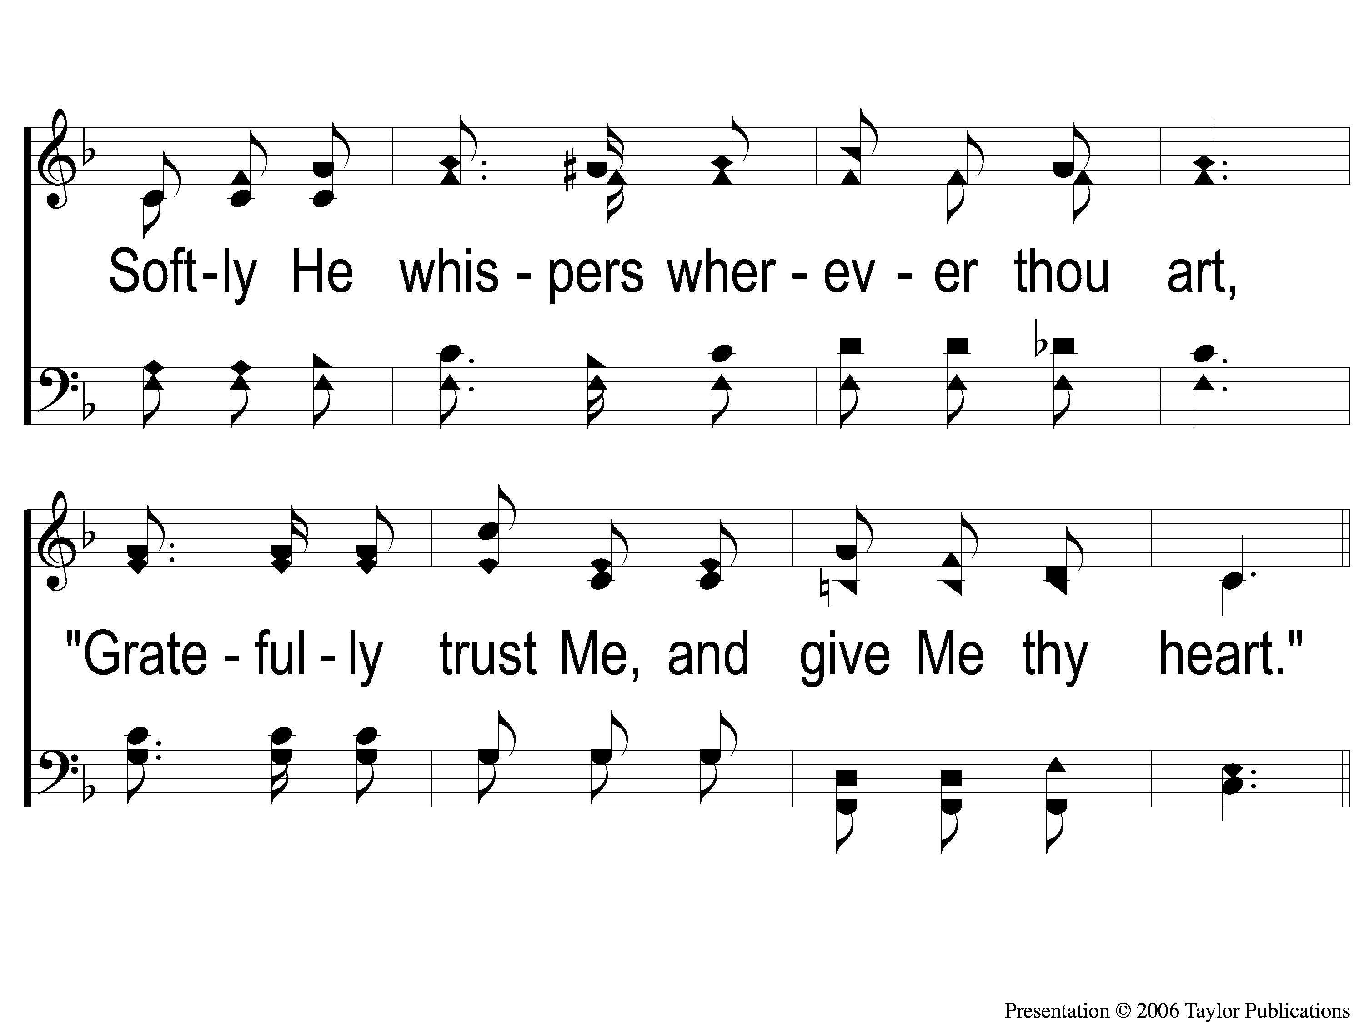
1-2 Give My Thy Heart
Give Me Thy Heart
126

Slide 3
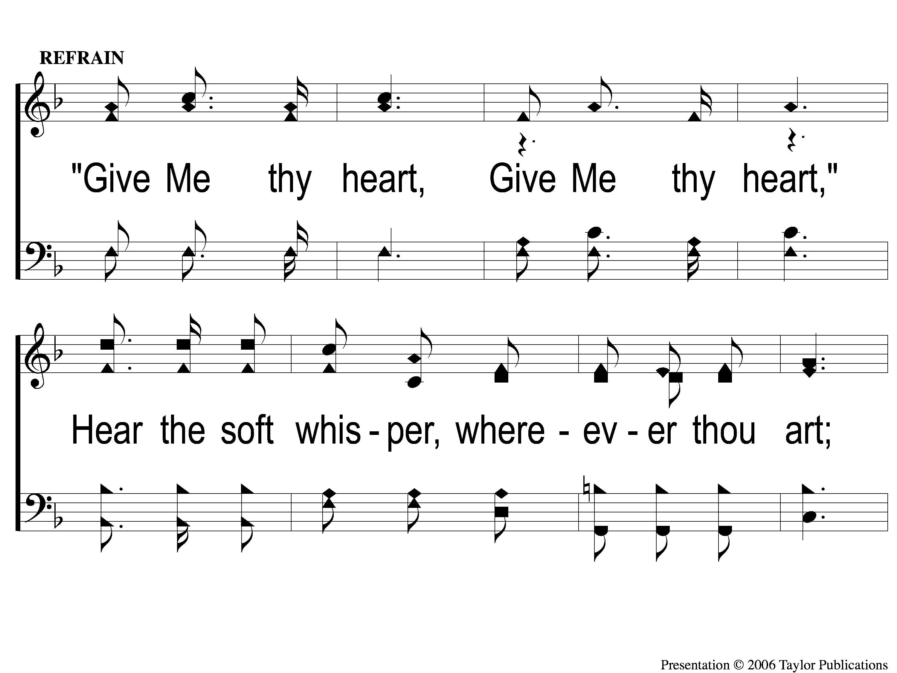
C-1 Give My Thy Heart
Give Me Thy Heart
126

Slide 4
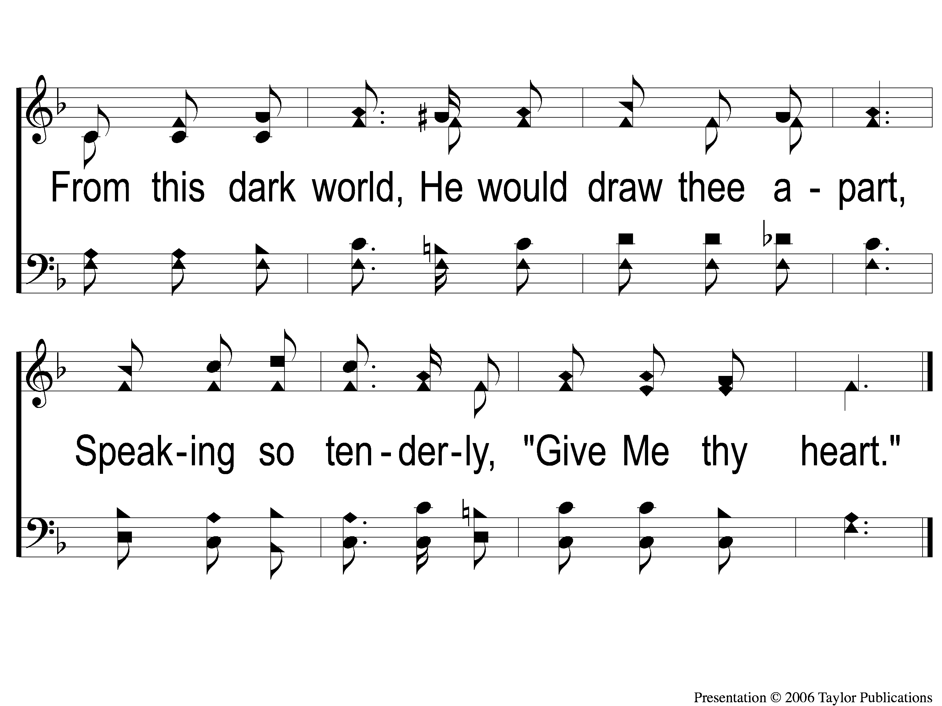
C-2 Give My Thy Heart
Give Me Thy Heart
126

Slide 5
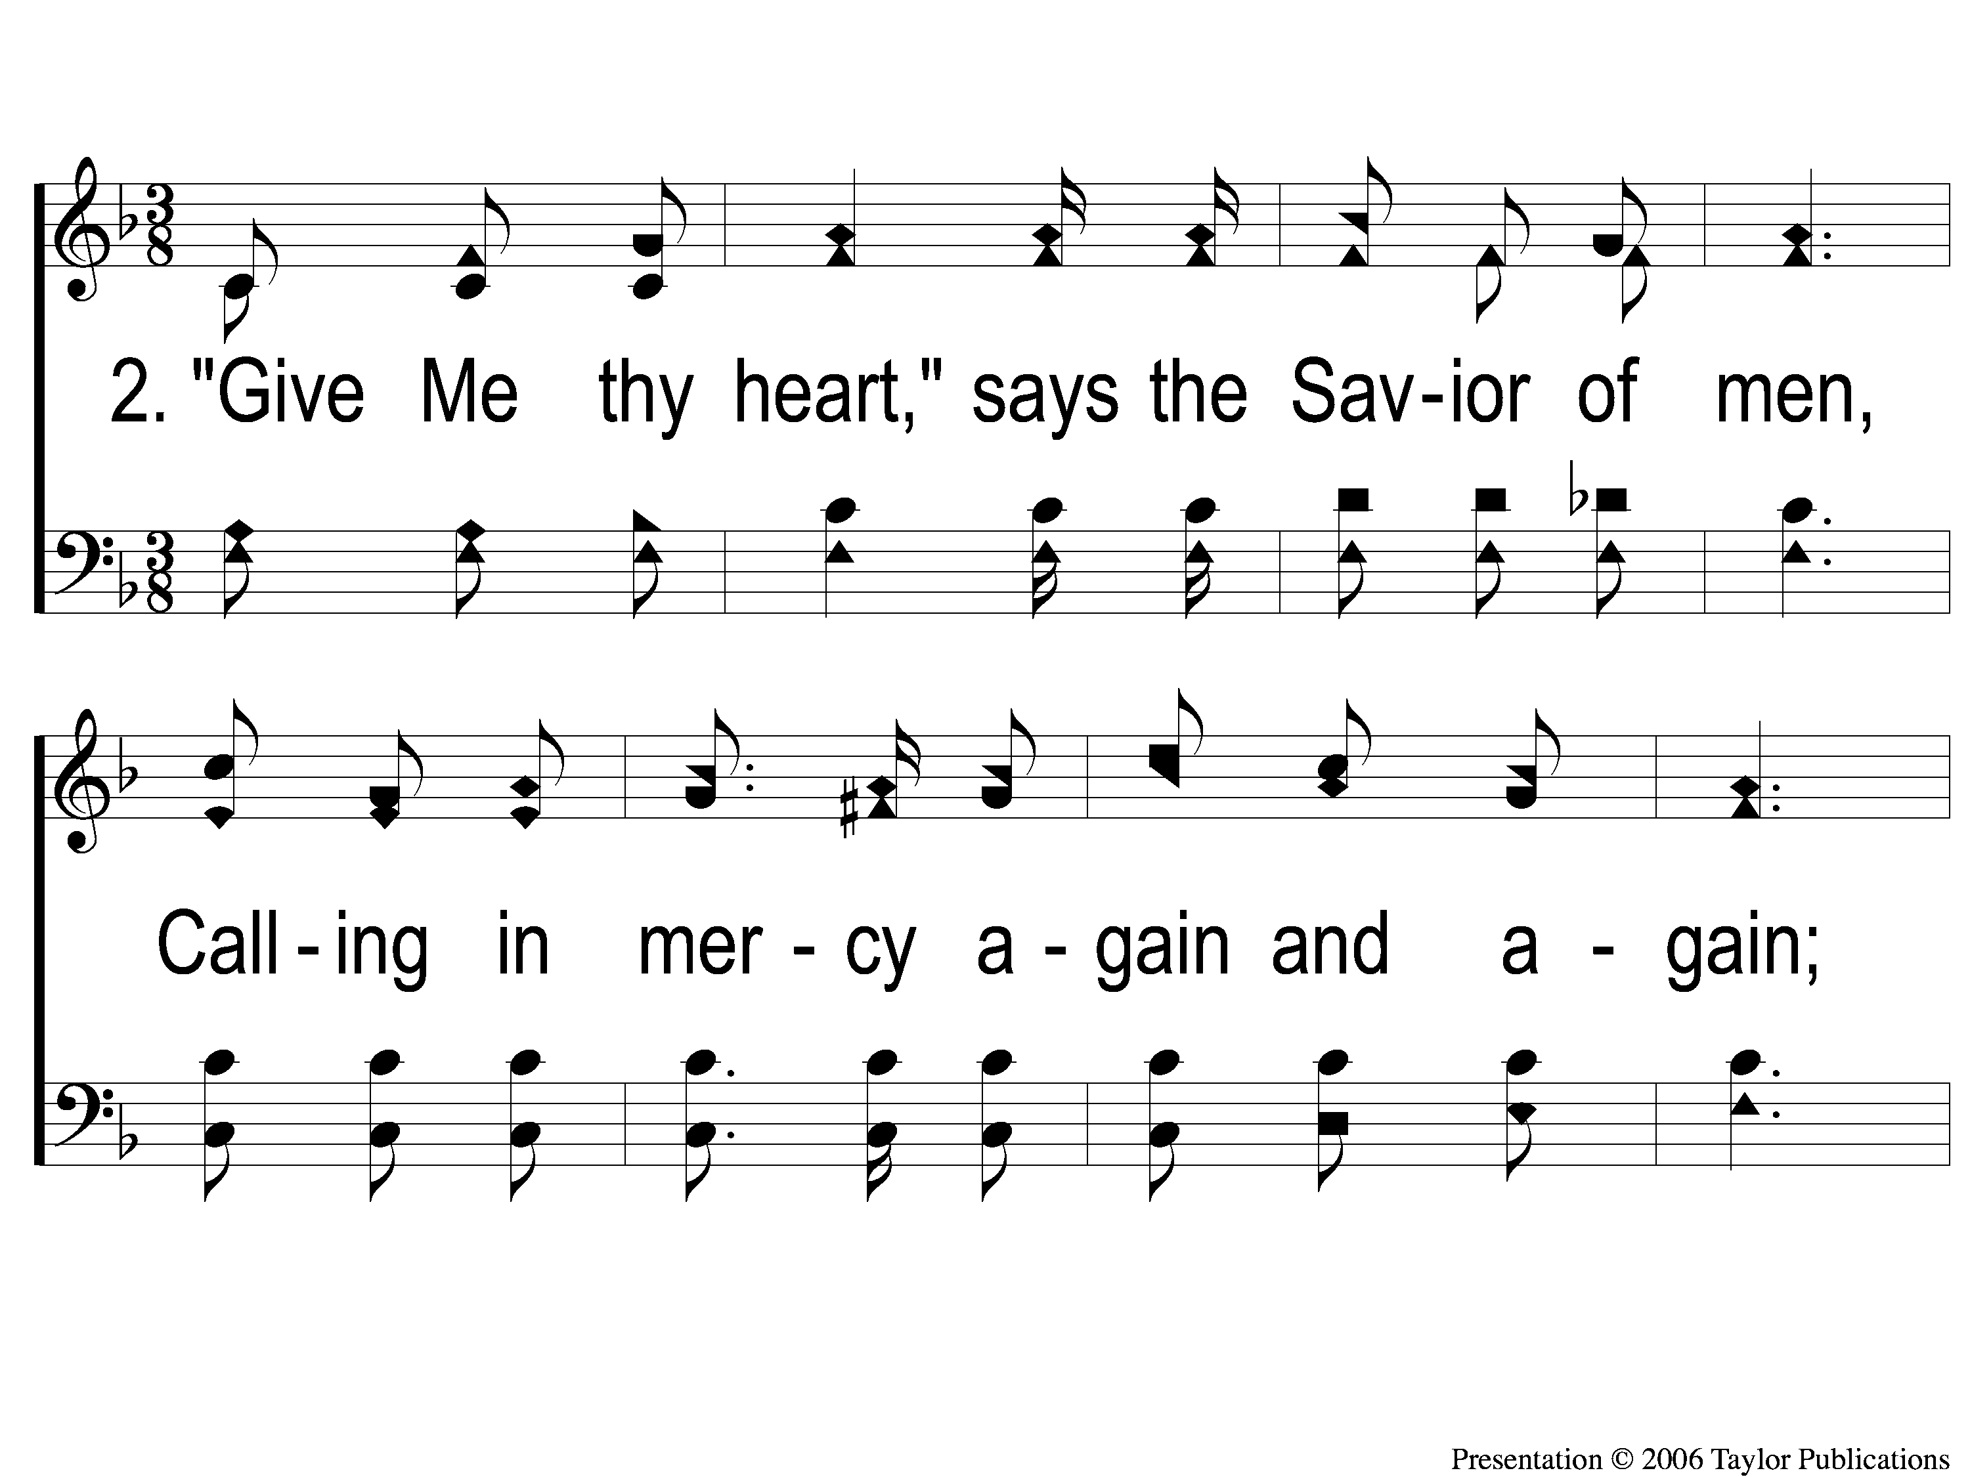
2-1 Give My Thy Heart
Give Me Thy Heart
126

Slide 6
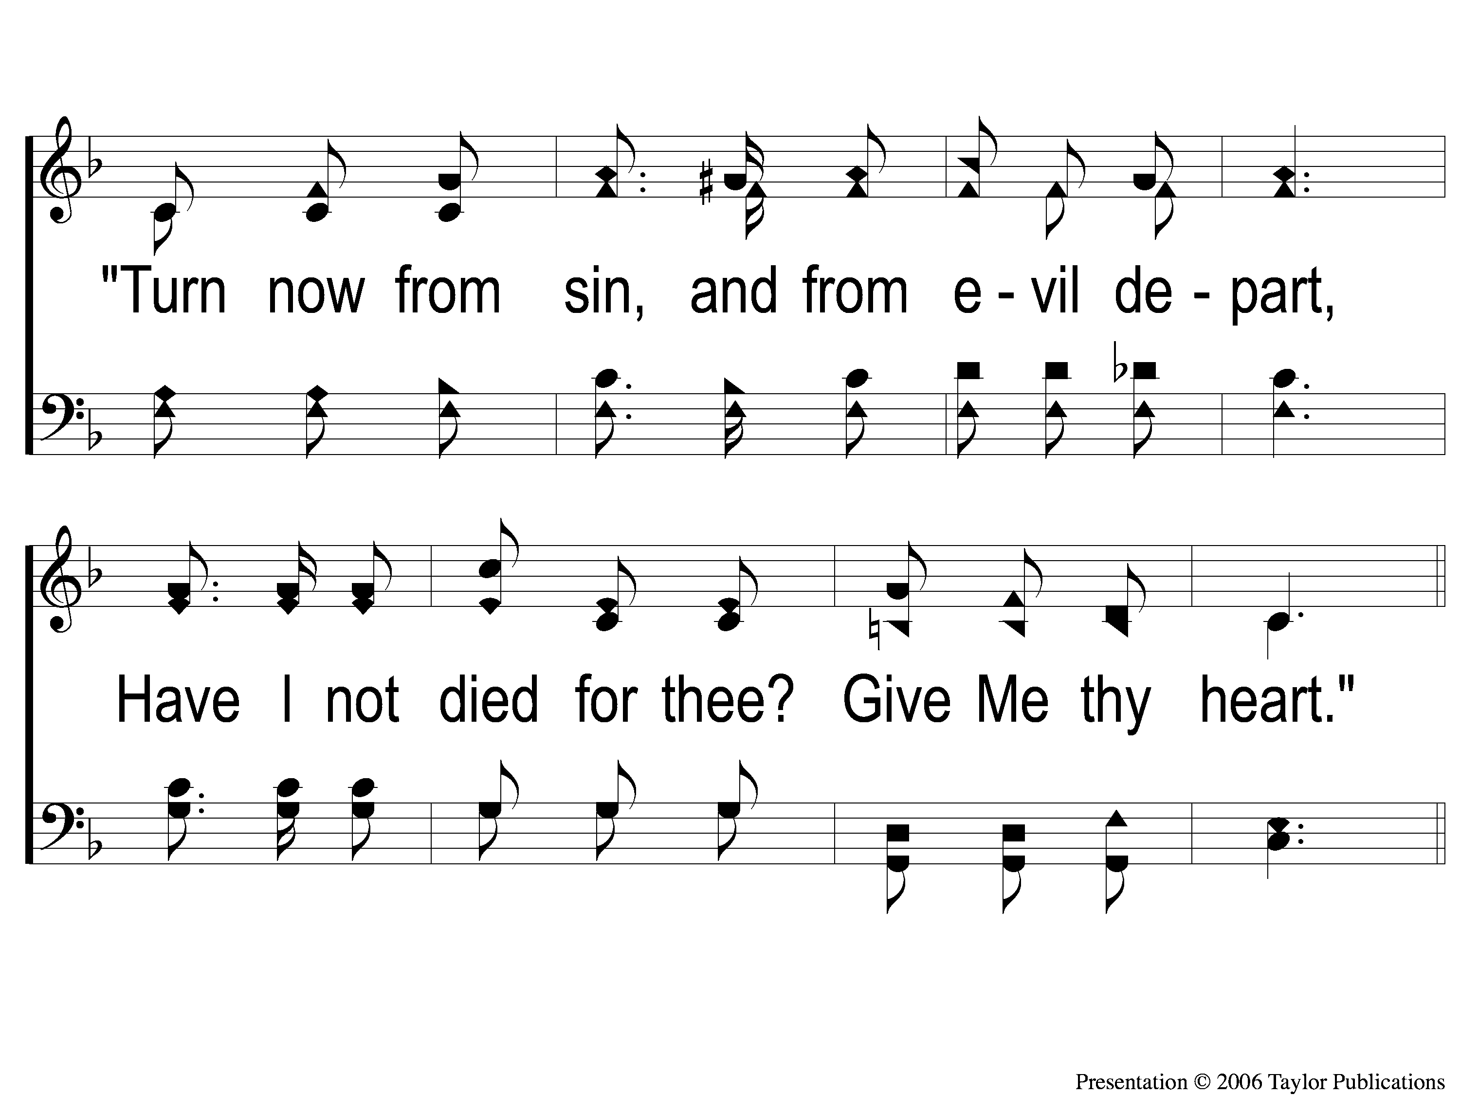
2-2 Give My Thy Heart
Give Me Thy Heart
126

Slide 7
C-1 Give My Thy Heart
Give Me Thy Heart
126

Slide 8
C-2 Give My Thy Heart
Give Me Thy Heart
126

Slide 9
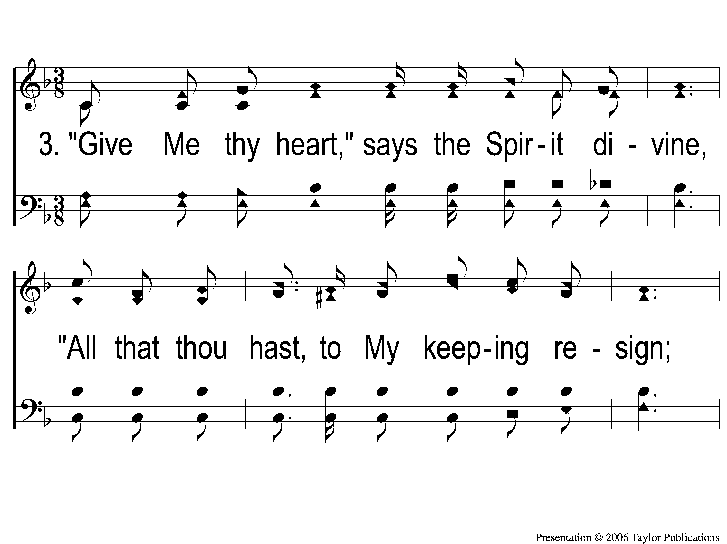
3-1 Give My Thy Heart
Give Me Thy Heart
126

Slide 10
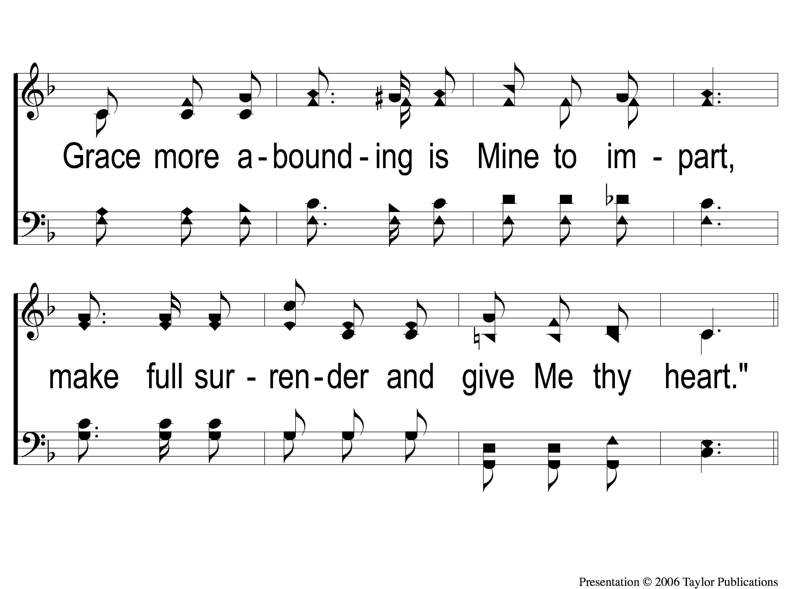
3-2 Give My Thy Heart
Give Me Thy Heart
126

Slide 11
C-1 Give My Thy Heart
Give Me Thy Heart
126

Slide 12
C-2 Give My Thy Heart
Give Me Thy Heart
126

